Slide 1

LAB PRACTICE - 4: MINI-PROJECT (DATA SCIENCE) Loan Prediction System
COURSE FACULTY: Prof. Leena A. Deshpande

Slide 2
Team Details
Sr.No. | Name | Division and Batch | Roll Number | GR.No.
1 | Sanket Sonje | B – B2 | 322053 | 17u176
2 | Shardul Pathak | B – B2 | 322057 | 17u666

Slide 3

Contents
Description
Data Set variables
Objective
How the data is created?
Process flow of project:
Concepts
Pre-processing of Data
Classifier: Models
Code
Output

Slide 4
Problem Statement
We wants to automate the loan eligibility process (real time) based on customer detail provided while filling online application form.
These details are Gender, Marital Status, Education, Number of Dependents, Income, Loan Amount, Credit History and others.
To automate this process, they have given a problem to identify the customers segments, those are eligible for loan amount so that they can specifically target these customers.

Slide 5
Objectives of the Project
Main Objective: -
Automate the Loan Eligibility Process (Real Time).
Sub-Objectives: -
Extract the data from Datahack as a Resource.
Analyse the data and fit into the classification model.
Perform and Evaluate the model and predict the Loan Status of entries Test Dataset.

Slide 6
Data set Variables
Variable | Description
Loan_ID | Unique Loan ID
Gender | Male/ Female
Married | Applicant married (Y/N)
Dependents | Number of dependents
Education | Applicant Education (Graduate/ Under Graduate)
Self_Employed | Self employed (Y/N)
ApplicantIncome | Applicant income
CoapplicantIncome | Coapplicant income
LoanAmount | Loan amount in thousands
Loan_Amount_Term | Term of loan in months
Credit_History | credit history meets guidelines
Property_Area | Urban/ Semi Urban/ Rural
Loan_Status | Loan approved (Y/N)

Slide 7
Analyze problem and convert it into data
How data collected: -
Datahack (Resource)
How data stored:
Data is stored in the format of csv file.
Test.csv
Train.csv

Slide 8
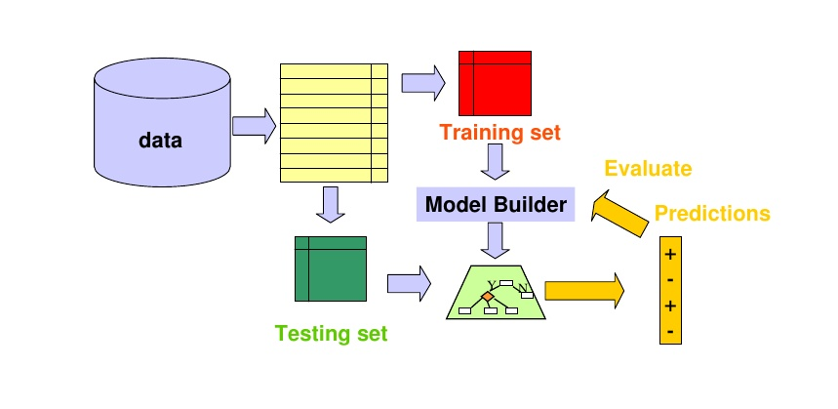
Flow of the Project

Slide 9
Flow of the Project
Importing all libraries and storing data sets.
Understanding various features of the datasets.
Understanding the Distribution of Non-Categorial values.
Understanding the Distribution of Categorial values.
Replacing the Null values of Self Employed column with maximum occurrence of the data
Nullifying Outliers of Loan Amount and Amount Income.
Data preparation and model building.
Testing and Validating score.

Slide 10
Logistic Regression
Logistic Regression is used when the dependent variable(target) is categorical.
For example,
To predict whether an email is spam (1) or (0)
Whether the tumor is malignant (1) or not (0)
In our example, Our Targeted Value is “Loan Status” and it has values Yes or No.
To validate our Accuracy, we calculate the Cross Validation Score.

Slide 11
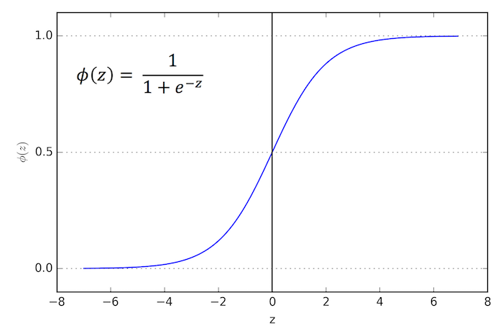
Logistic Regression

Slide 12
Types of Logistic Regression
Binary Logistic Regression: -
The categorical response has only two 2 possible outcomes. Example: Spam or Not. We use this type.
Multinomial Logistic Regression: -
Three or more categories without ordering. Example: Predicting which food is preferred more (Veg, Non-Veg, Vegan)
Ordinal Logistic Regression: -
Three or more categories with ordering. Example: Movie rating from 1 to 5

Slide 13
Analyze problem and convert it into data
How data represented using statistical model: -
Data distribution: Binary Logistic Regression Model.
Statistical operations performed: -
Min(), Avg(), describe(), Mode(), etc.
Dealing with missing values: -
NAN, zero values /variable conversion.

Slide 14
Model building and training
Model used : - > Logistic Regression Model
Binary output is expected.
Libraries to be used : - >
SKLEAN, SCIKIT, PANDAS, NUMPY, etc.

Slide 15
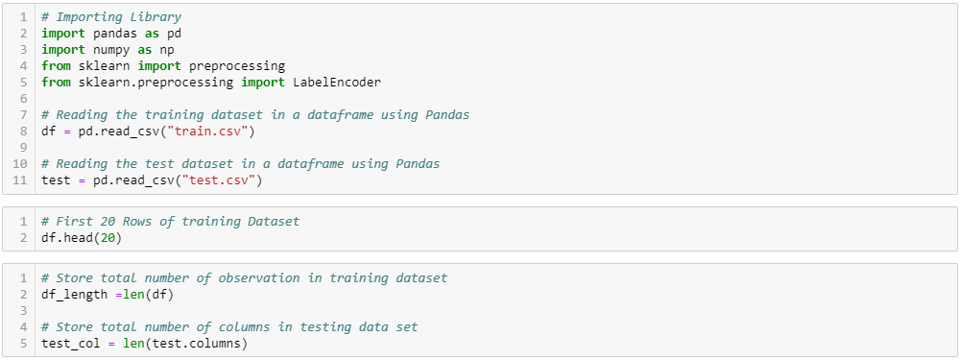
Code :- Importing Libraries

Slide 16
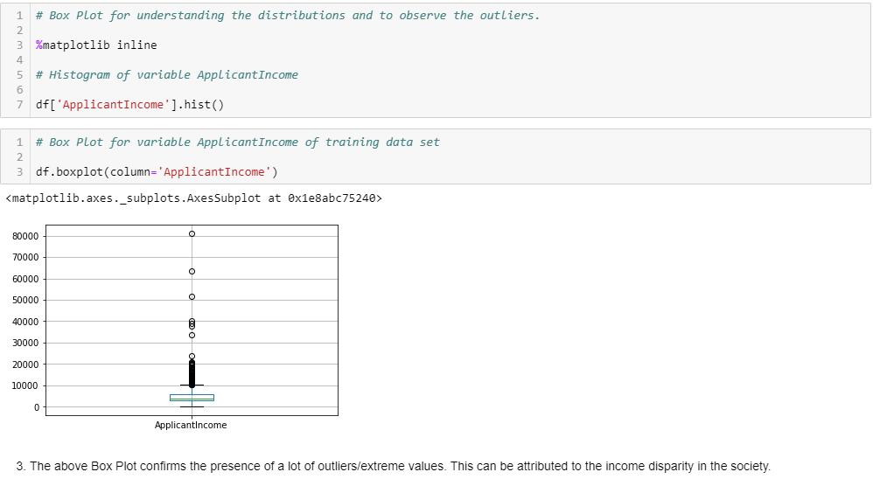
Understanding Distribution of Numerical Values 1.ApplicationIncome

Slide 17
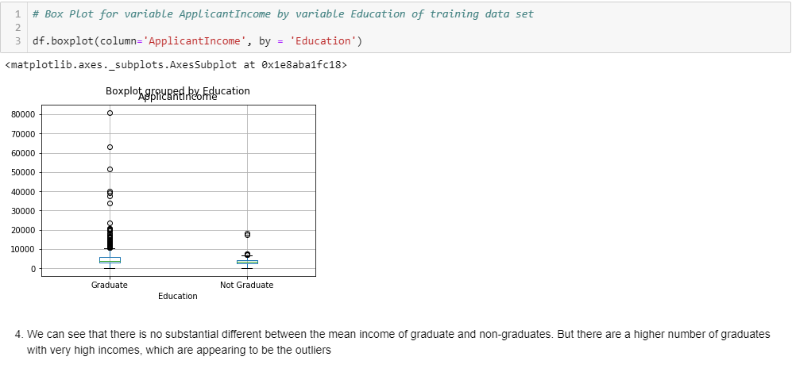
Understanding Distribution of Numerical Values 1.ApplicationIncome

Slide 18
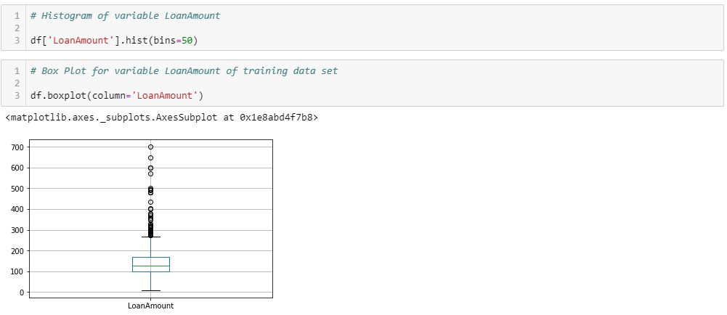
Understanding Distribution of Numerical Values 2.LoanAmount

Slide 19
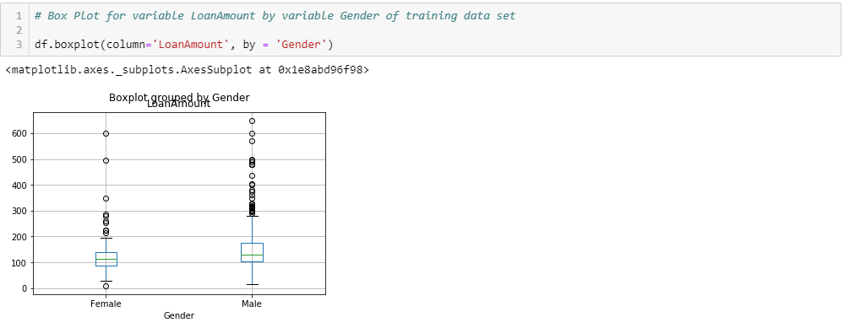
Understanding Distribution of Numerical Values 2.LoanAmount

Slide 20
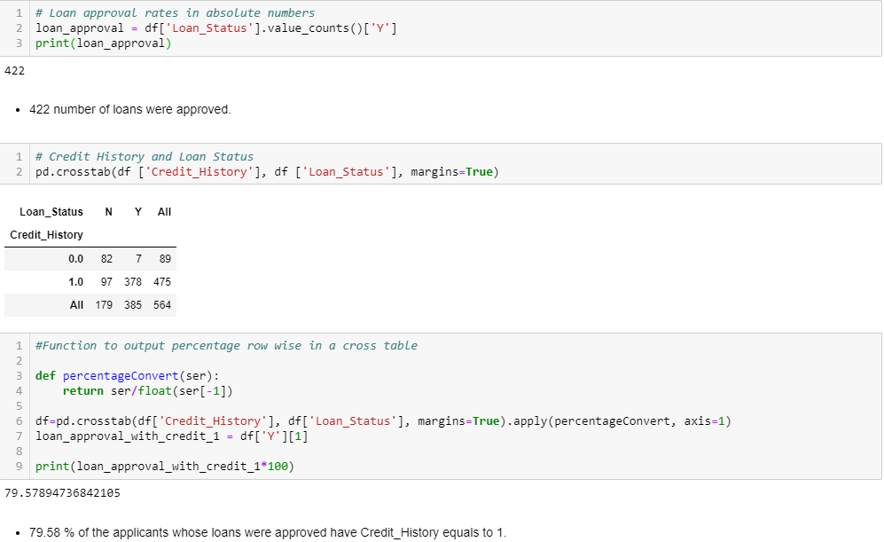
Understanding Distribution of Categorical Variables

Slide 21
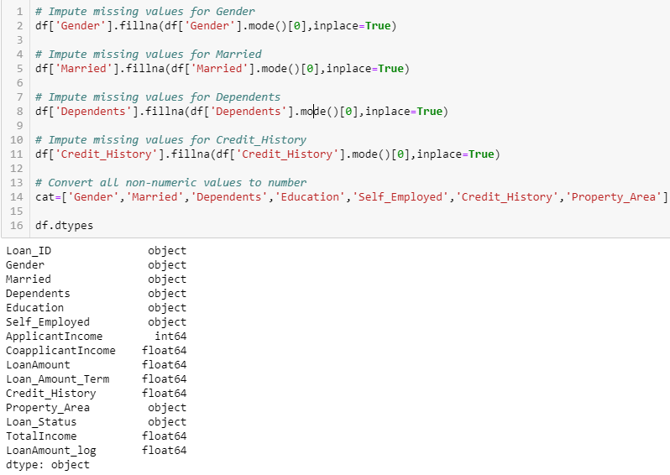
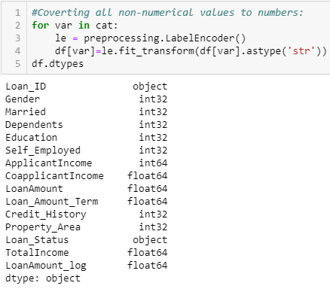
Data Preparation And Model Building

Slide 22
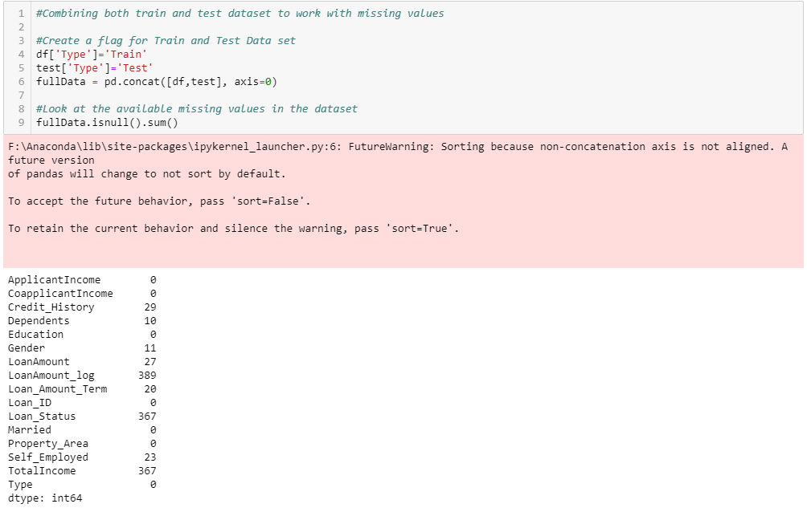
Data Preparation And Model Building

Slide 23
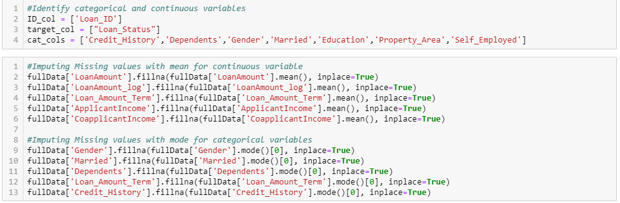
Data Preparation And Model Building

Slide 24
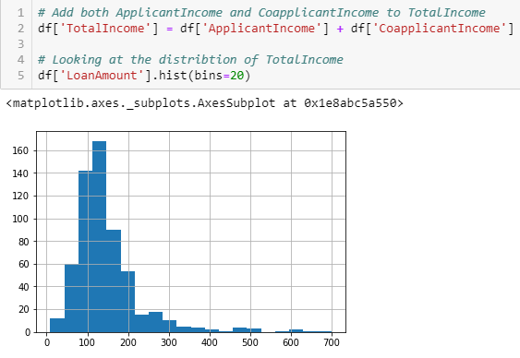
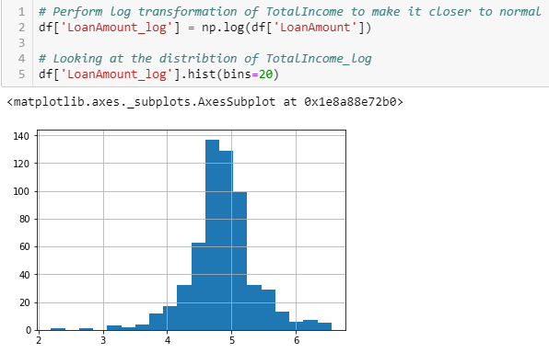
Nullify the Effect of Outliers 1. Loan Amount

Slide 25
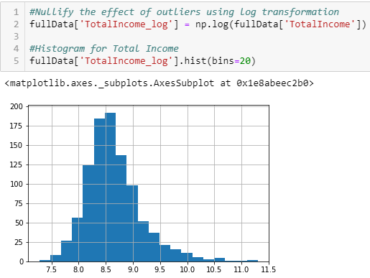
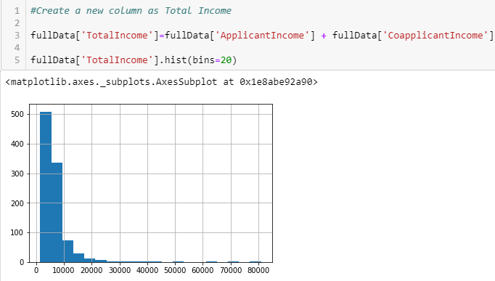
Nullify the Effect of Outliers 2. Total Income

Slide 26
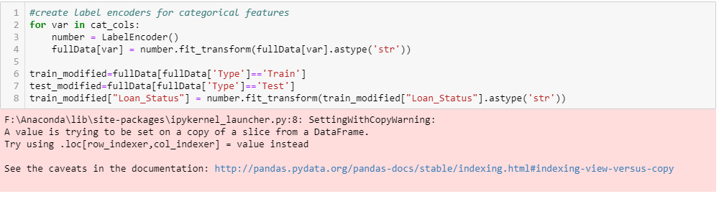
Data Preparation And Model Building

Slide 27
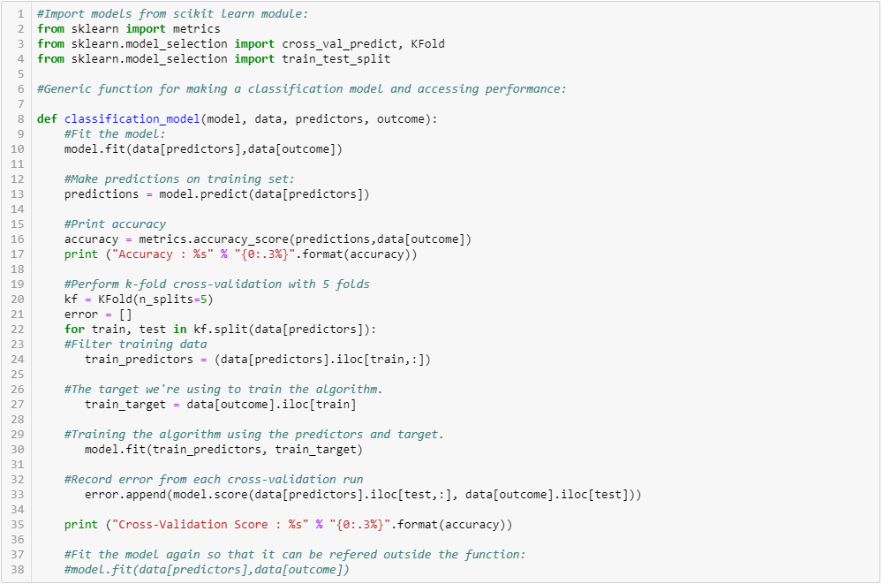
Classification Model

Slide 28
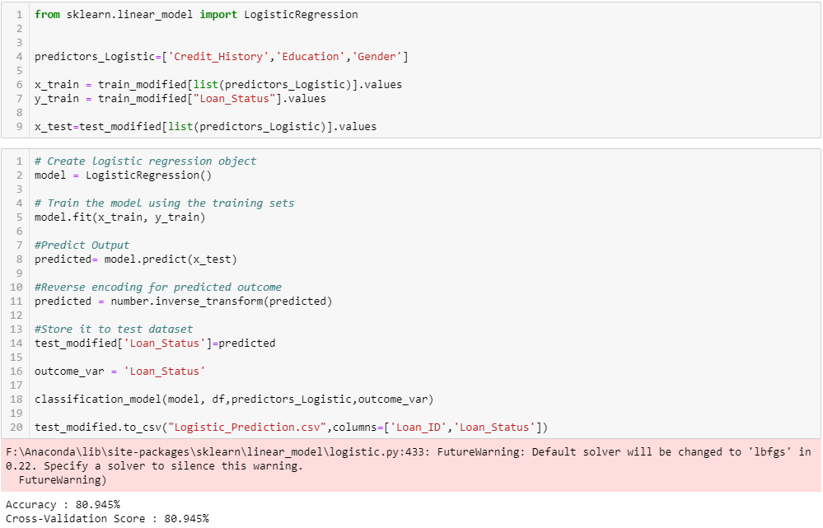
Logistic Regression Model and Output

Slide 29
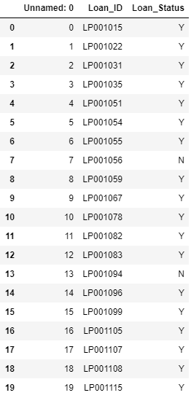
Output
Logistic Regression csv File.

Slide 30
Conclusion And Observations
The chances of getting a loan will be higher for:
Applicants having a credit history (we observed this in exploration.)
Applicants with higher applicant and co-applicant incomes
Applicants with higher education level
Properties in urban areas with high growth perspectives

Slide 31
Analyzing and interpreting the results
Test the result on different samples: -
Training data
Testing dataset
Accuracy: - 80.945%
Cross – Validation Score: - 80.945%

